Slide 1
Polygyny & Polyandry
By Kourtney Davenport

Slide 2


Exactly, what is polyandry & polygyny ?
Polyandry is when a woman has more than one husband.
Polygyny is when a man has more than on wife.

Slide 3

“Don’t Pitch The Idea Just Yet”
If you were given the opportunity to become as one with your favorite movie stars, actors/ actresses, singers, or whom ever the others you may even consider spending your life with …. Would you ?
I don’t know about you but if I’m every given the opportunity to marry the guy I’m currently dating and Denzel Washington. “Point me to the church !!!”

Slide 4
Questions To Consider
Have you found yourself in a love triangle?
Cheating on someone?
Or have thoughts of being with someone else while actually in a relationship ?
Because if so, you my friend have skim the surface of polygamy. Which is why the subject is in exists in today world.

Slide 5
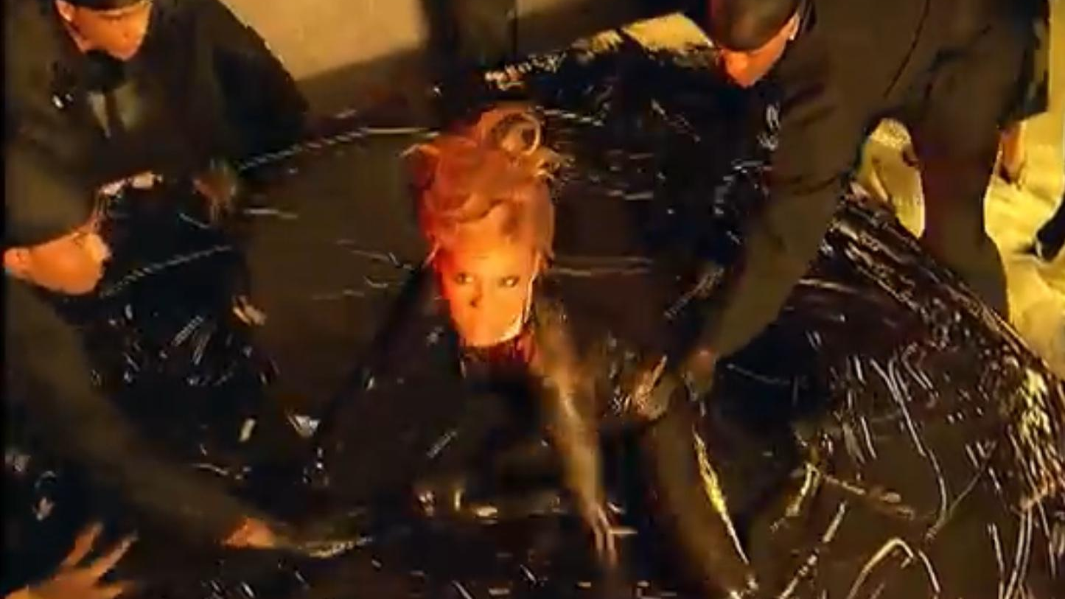

Slide 6
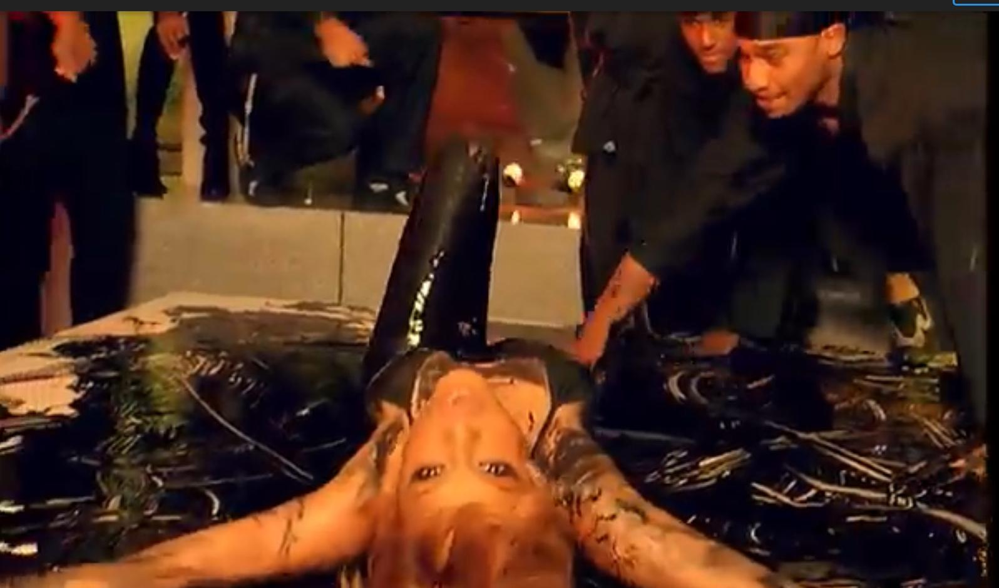

Slide 7
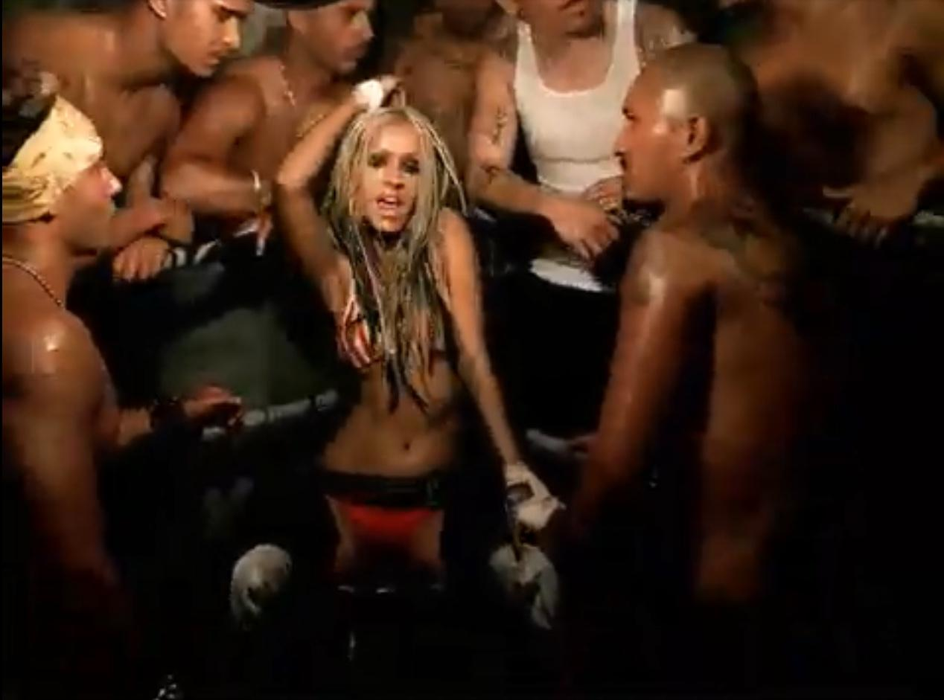

Slide 8
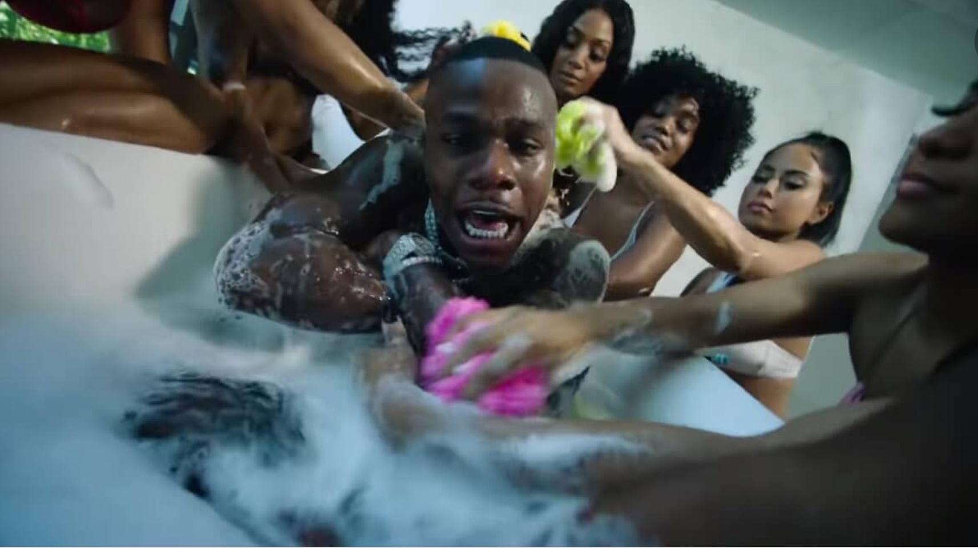

Slide 9
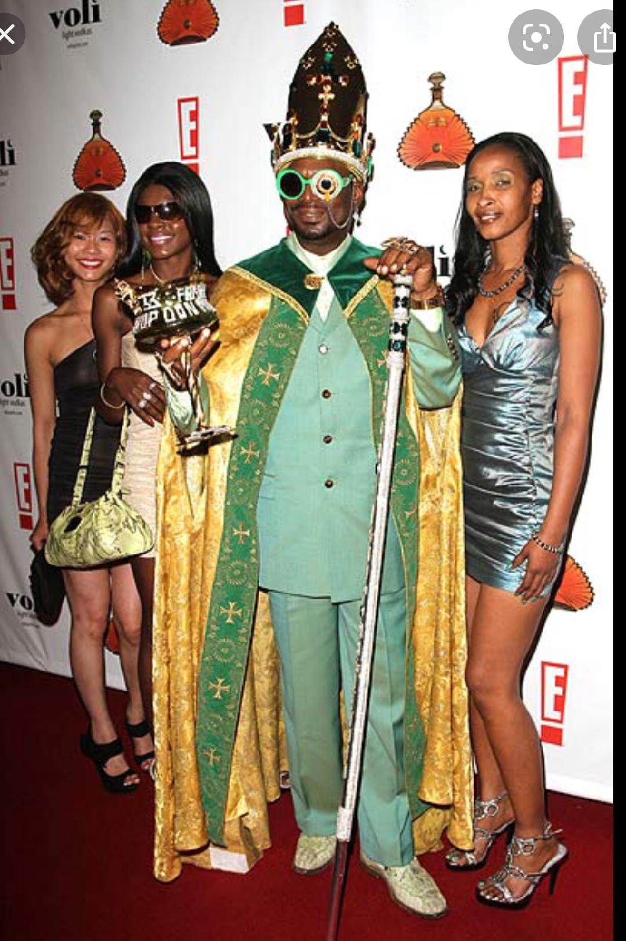

Slide 10
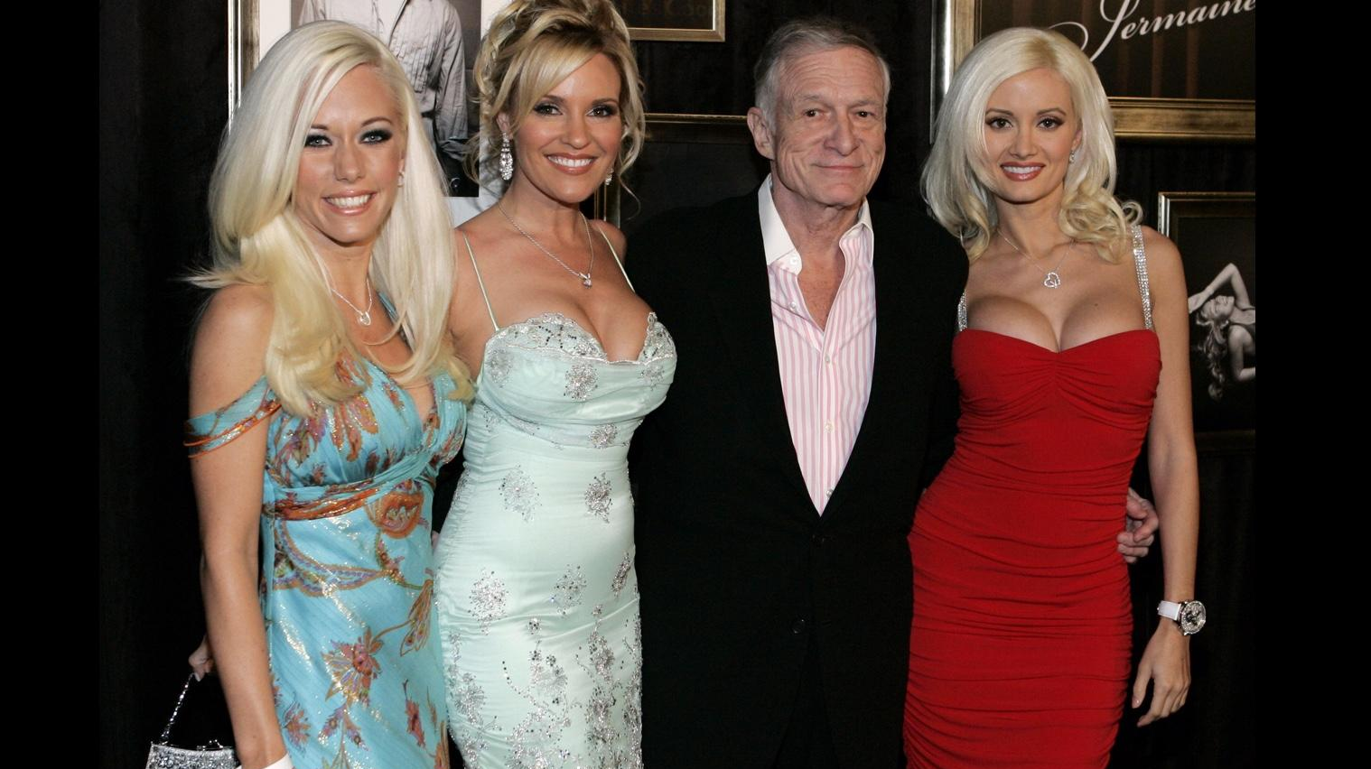

Slide 11
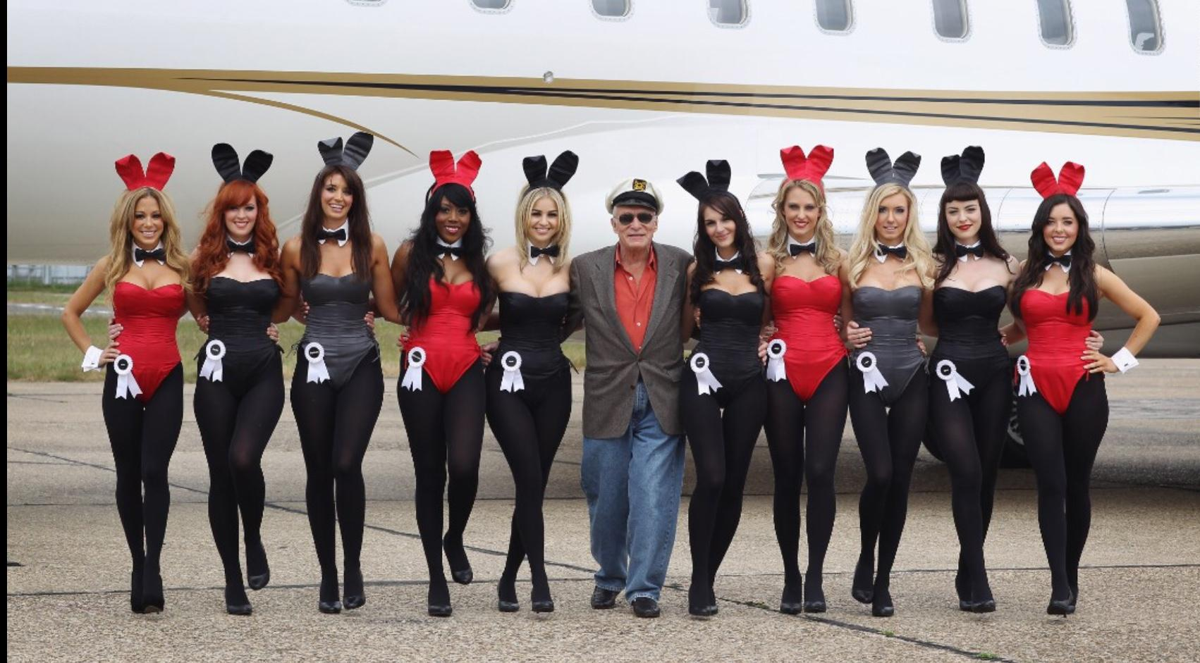

Slide 12


Slide 13


Slide 14


Slide 15
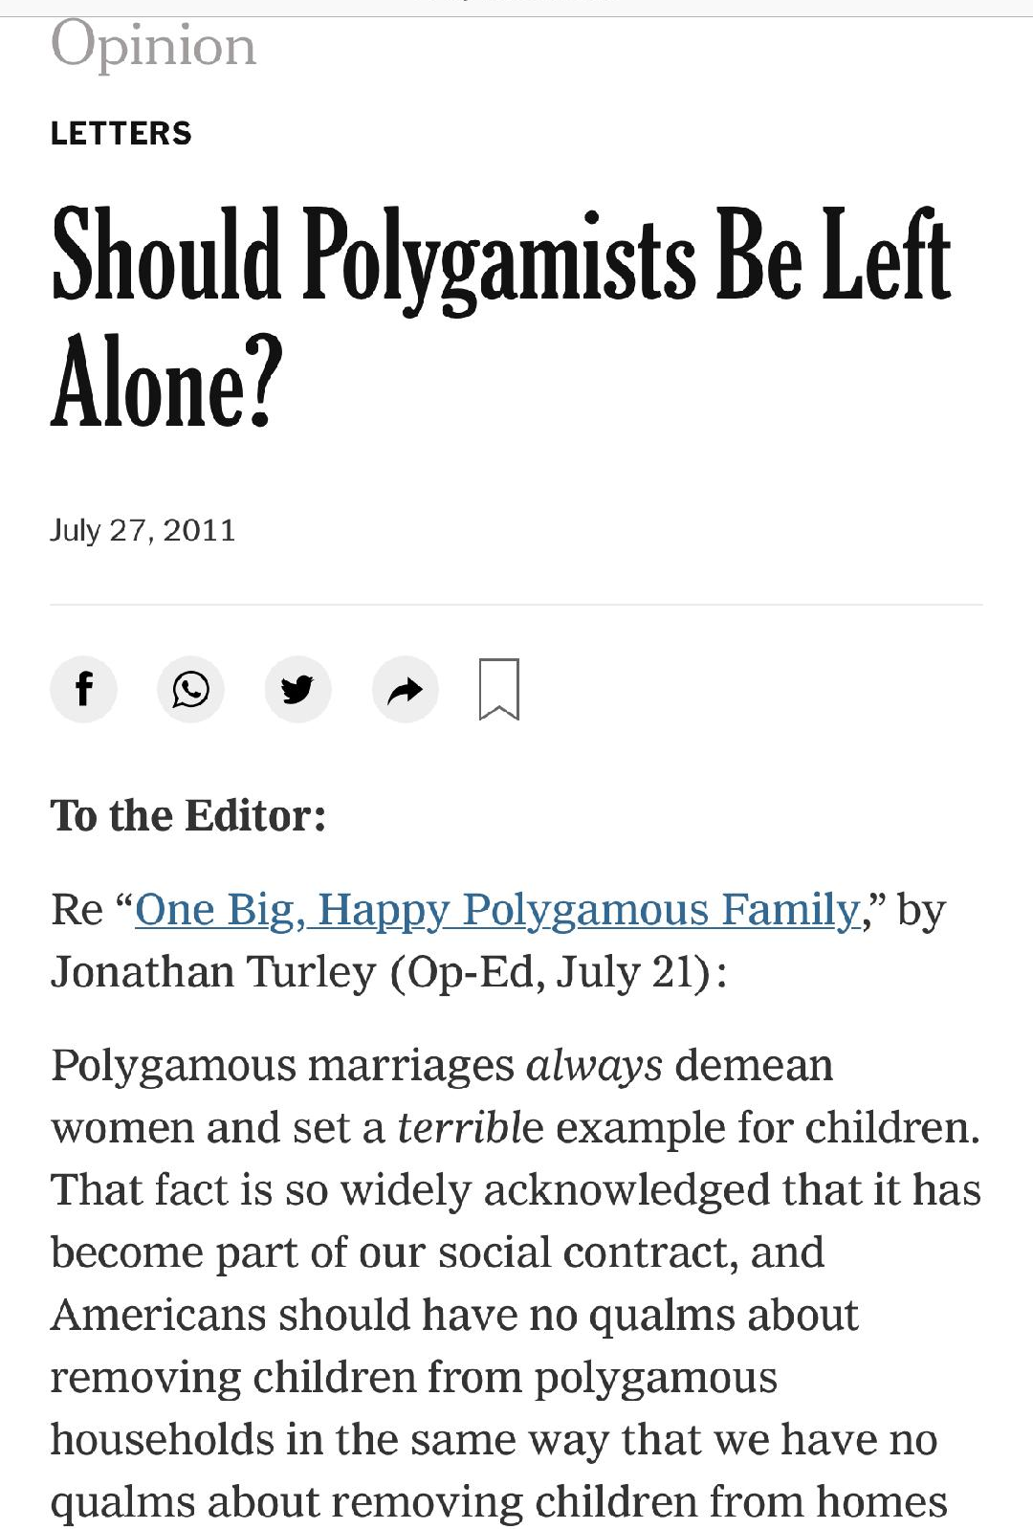
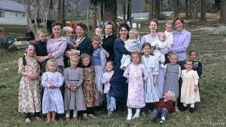

Slide 16
Credits
https://www.nytimes.com/2011/07/28/opinion/l28polygamy.html
Clip art of celebrites were taken from snapshots on youtube pictures and videos.
https://www.economist.com/international/2017/12/07/canadas-problem-with-polygamy
The Clip of the ramdom people were all take from google images
.https://rpcc.ent.sirsi.net/client/en_US/rpcc/search/results?qu=pologamy&te=&rt=false%7C%7C%7CSUBJECT%7C%7C%7CSubject
https://secure.syndetics.com/index.aspx?type=xw12&client=riverparishcc&upc=&oclc=&isbn=9780199746378/LC.JPG
https://rpcc.ent.sirsi.net/client/en_US/rpcc/search/results?qu=pologamy&rw=24&rt=false%7C%7C%7CSUBJECT%7C%7C%7CSubject&isd=true

